Slide 1


School of Engineering Technology and Applied Science
API Engineering
Week 01
Reza Dibaj

Slide 2
Creating Amazon EC2 Key Pairs

Slide 3
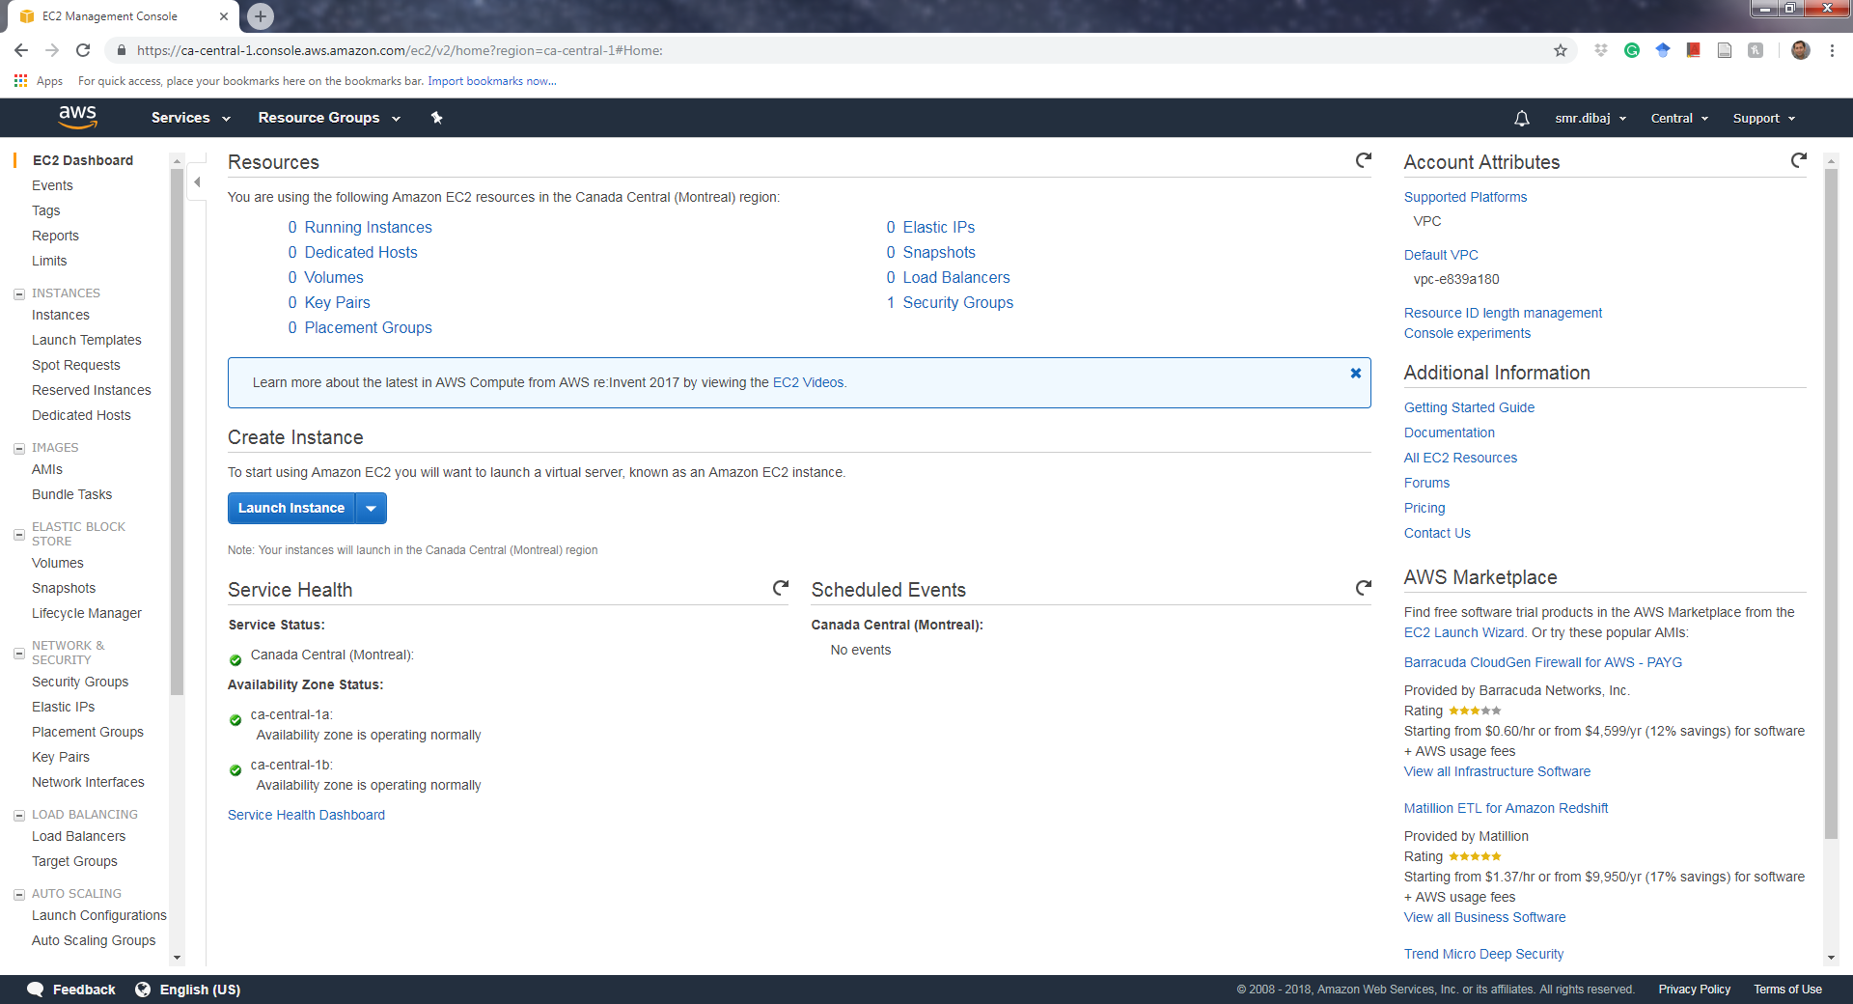
Creating Amazon EC2 Key Pairs
Step 1:

Slide 4
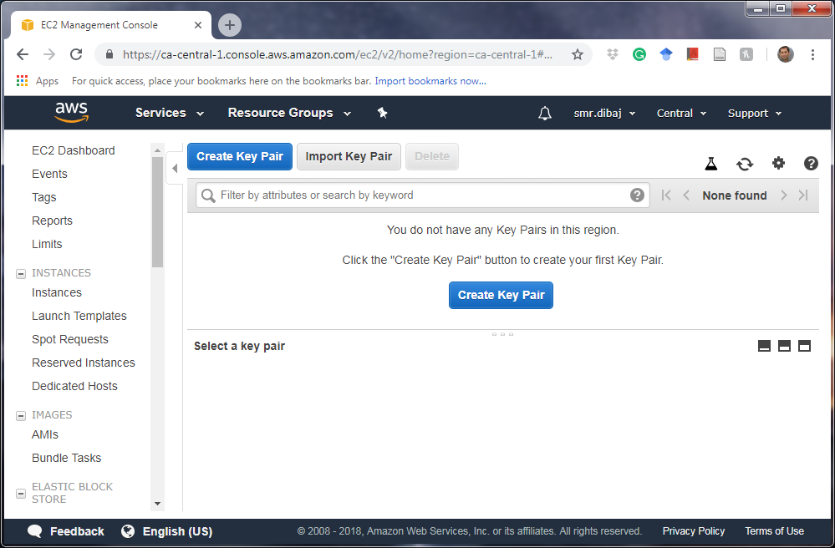
Creating Amazon EC2 Key Pairs
Step 2:

Slide 5
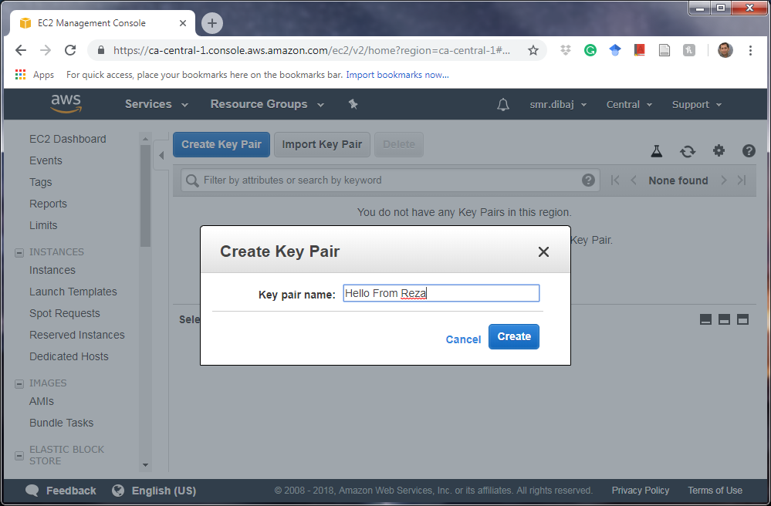
Creating Amazon EC2 Key Pairs
Step 3:

Slide 6
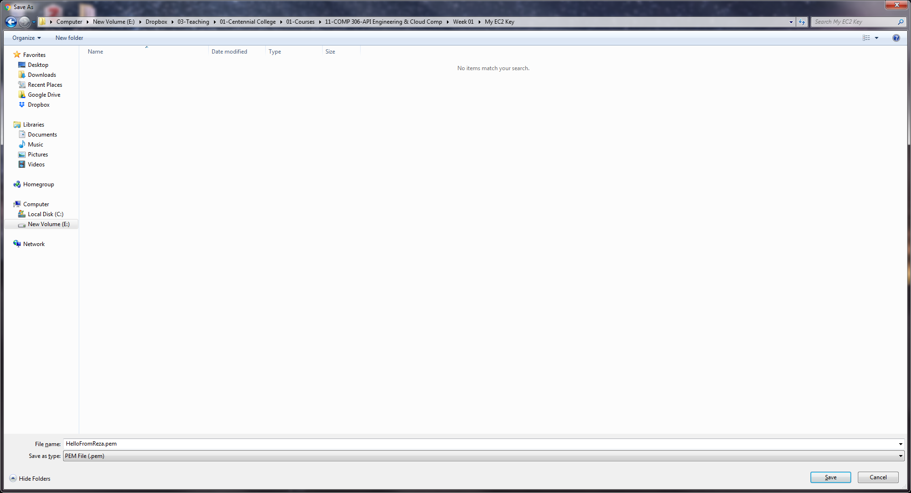
Creating Amazon EC2 Key Pairs
Step 4:

Slide 7
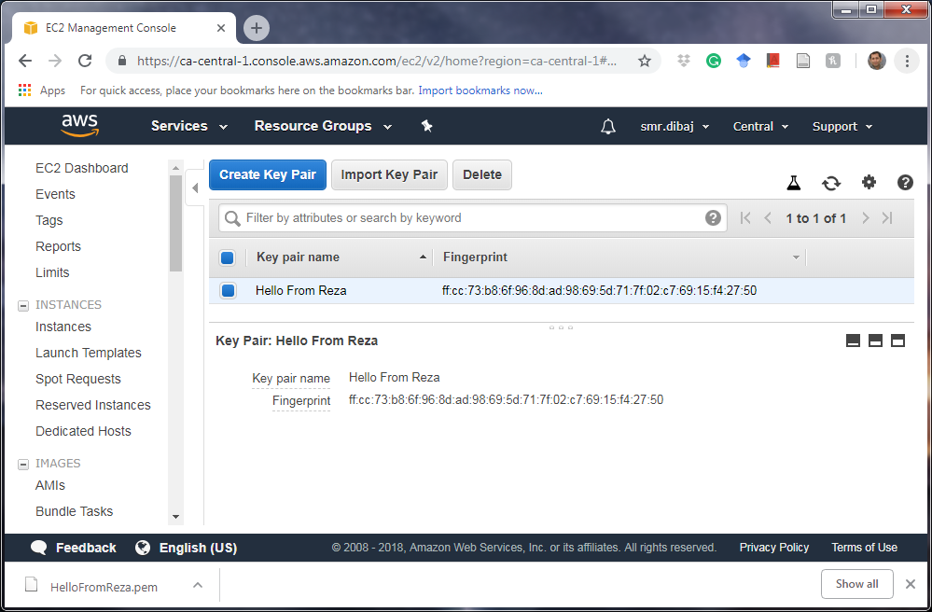
Creating Amazon EC2 Key Pairs
Step 5:

Slide 8
Launch EC2 Instance

Slide 9
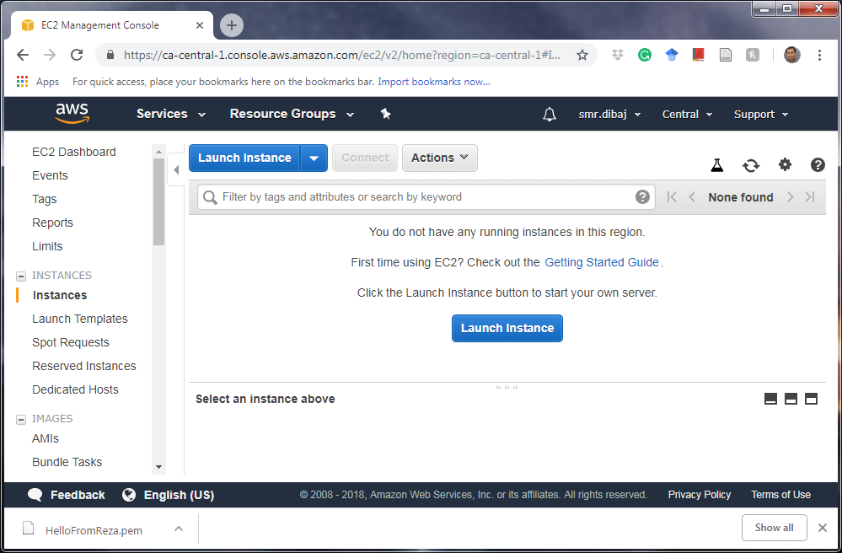
Launch EC2 Instance
Step 0:

Slide 10
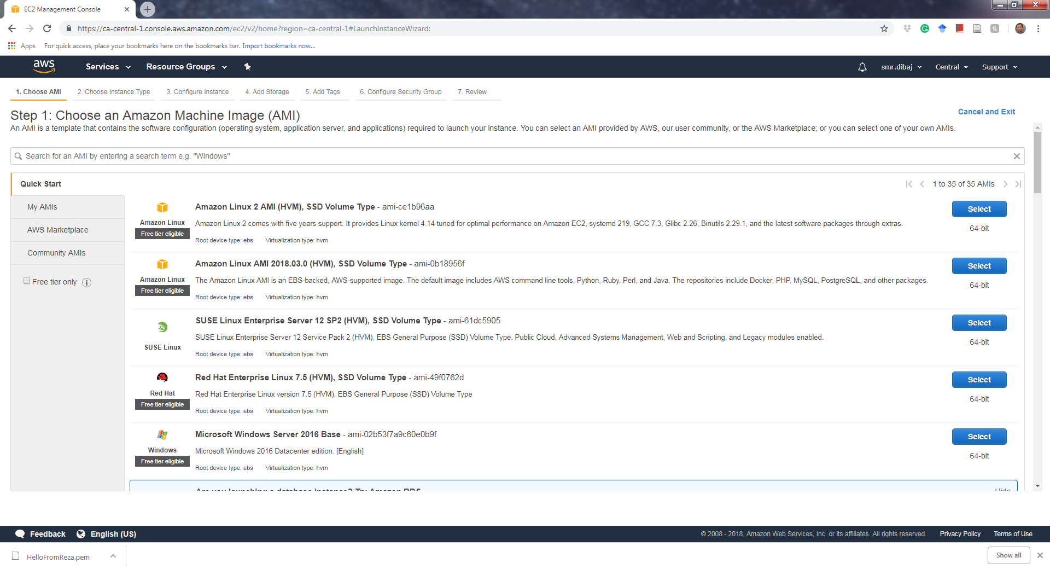
Launch EC2 Instance
Step 1:

Slide 11
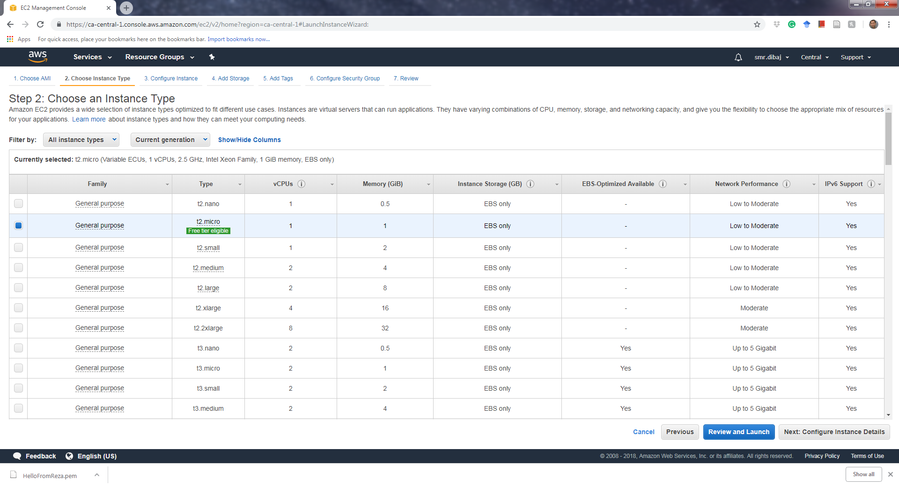
Launch EC2 Instance
Step 2:

Slide 12
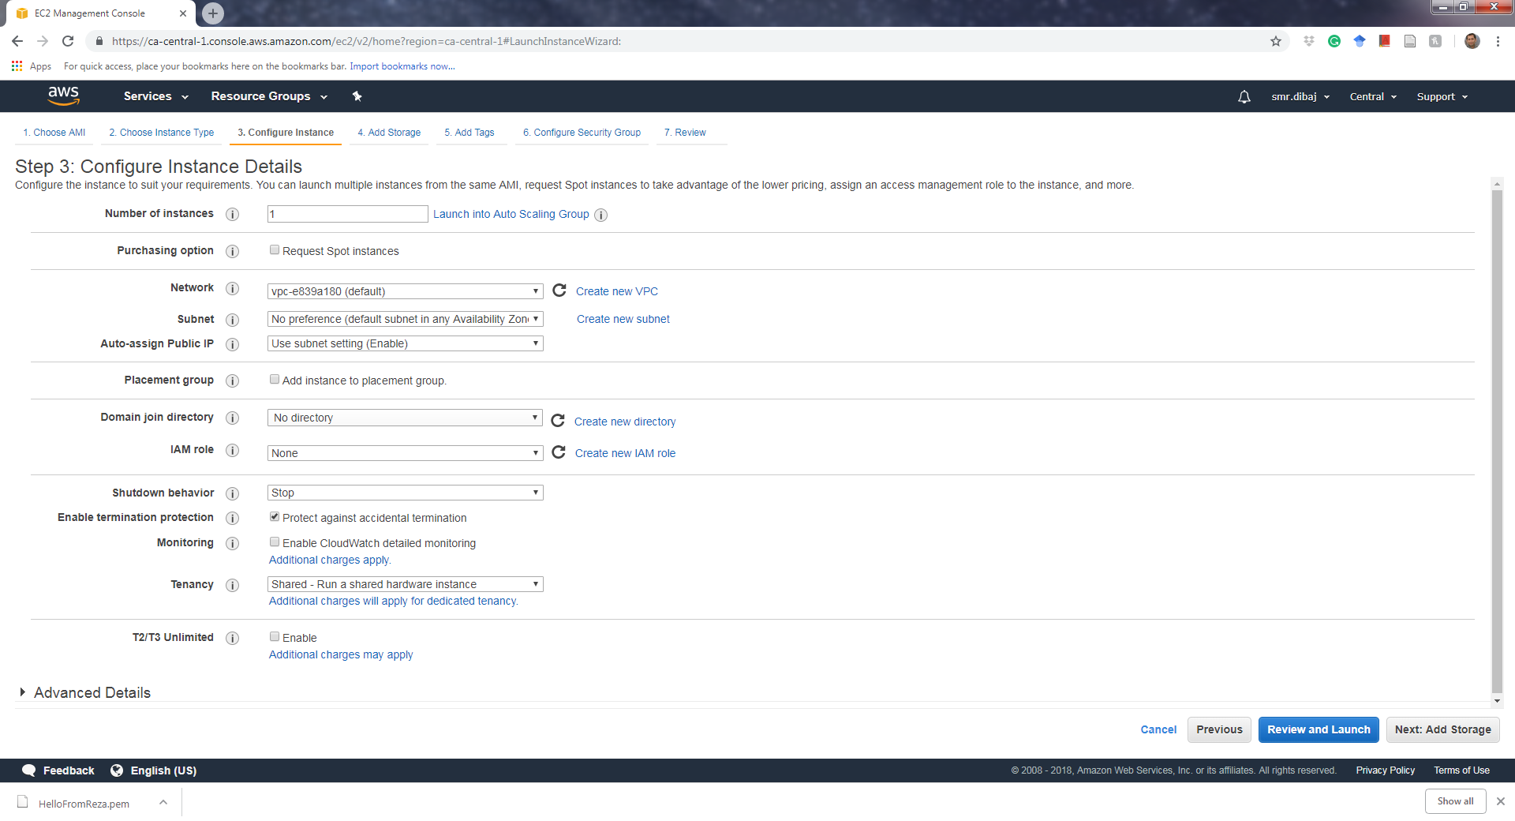
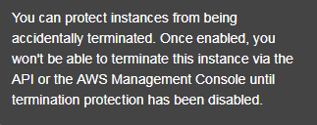
Launch EC2 Instance
Step 3:

Slide 13
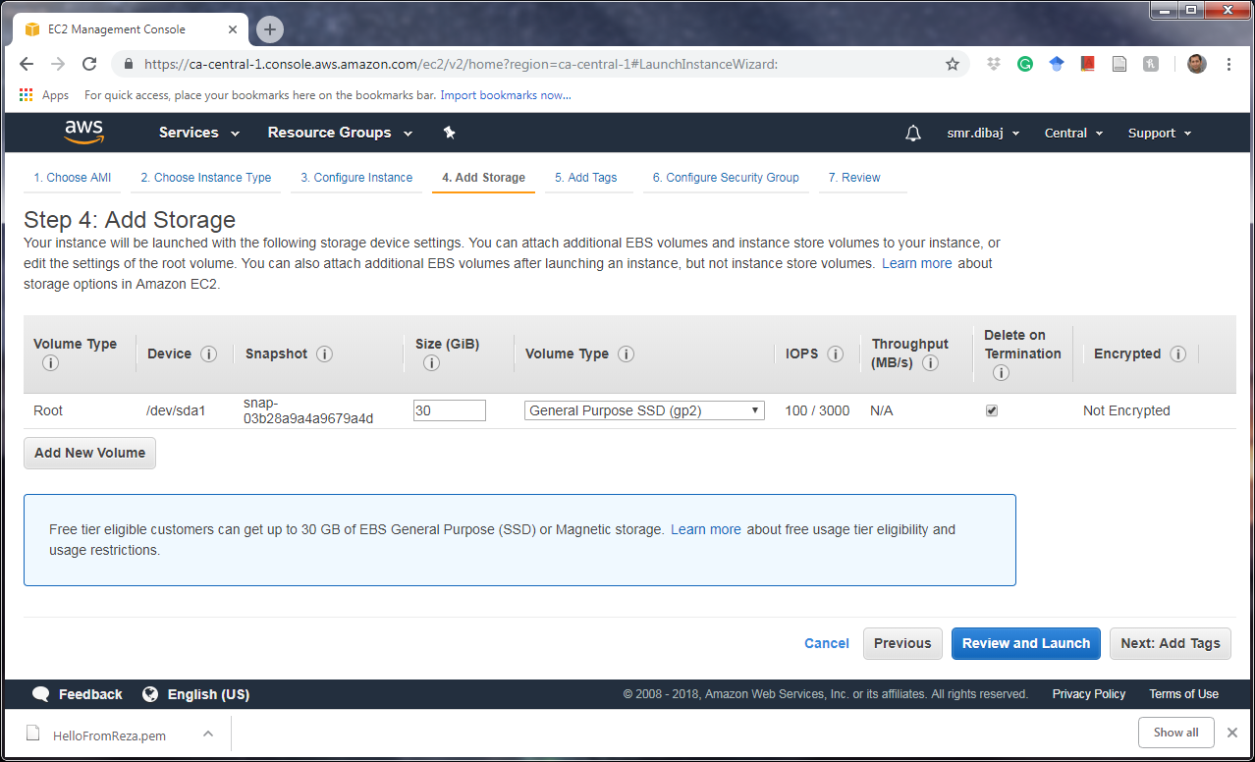
Launch EC2 Instance
Step 4:

Slide 14
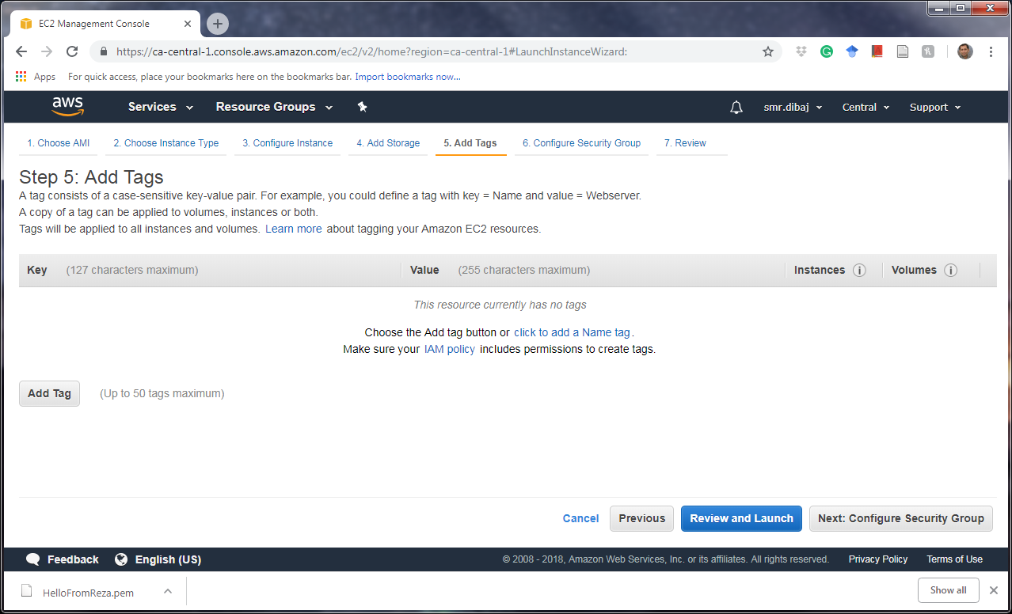
Launch EC2 Instance
Step 5:

Slide 15
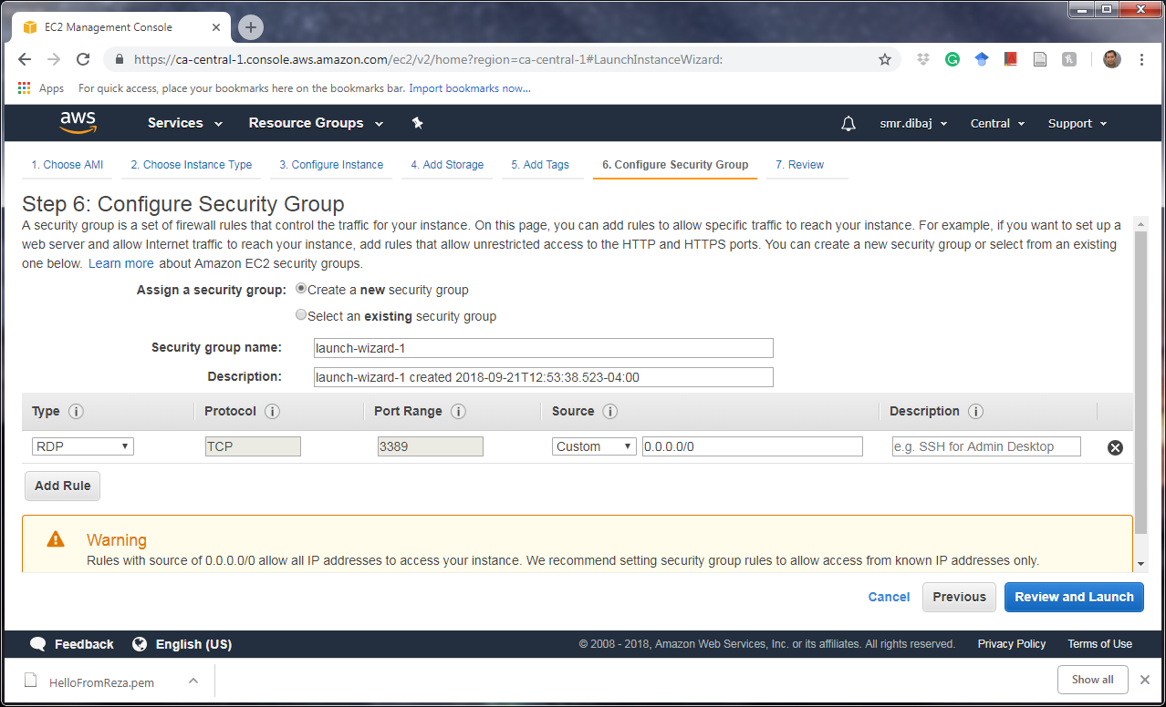
Launch EC2 Instance
Step 6:

Slide 16
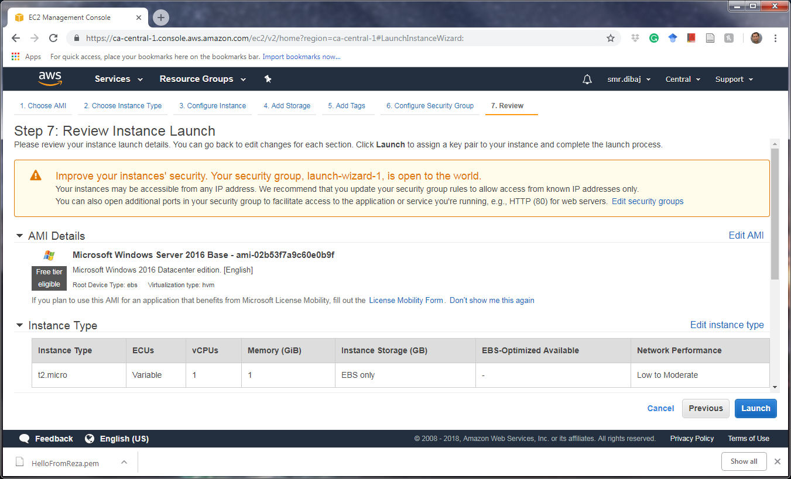
Launch EC2 Instance
Step 7:

Slide 17
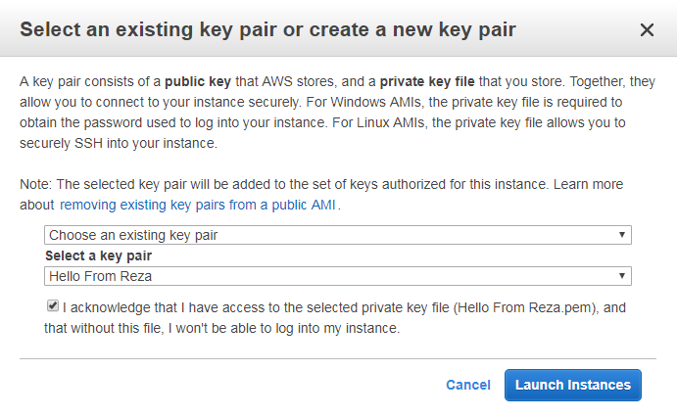
Launch EC2 Instance
Step 8:

Slide 18
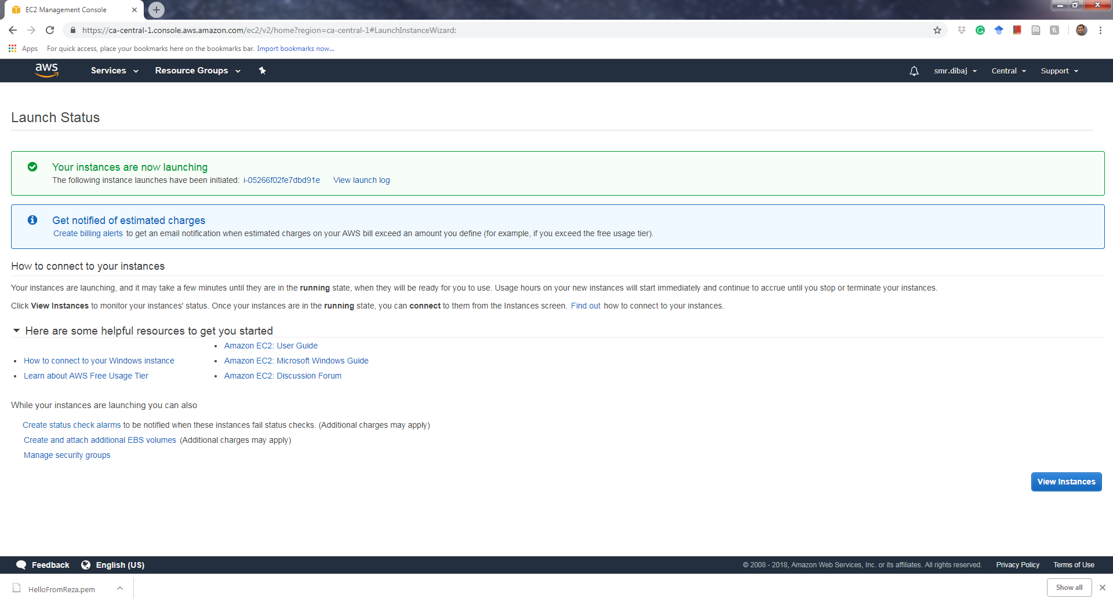
Launch EC2 Instance
Step 9:

Slide 19
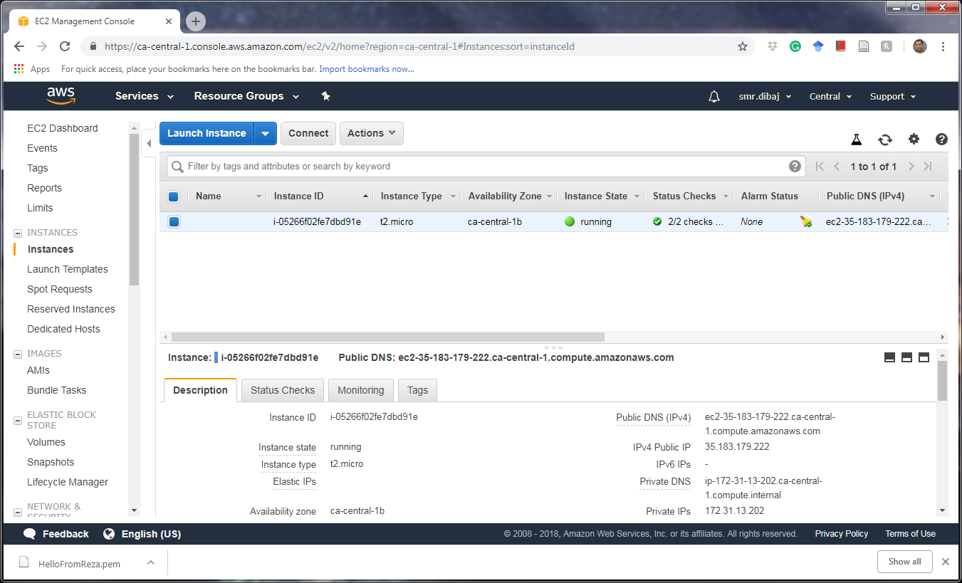
Launch EC2 Instance
Step 10:

Slide 20
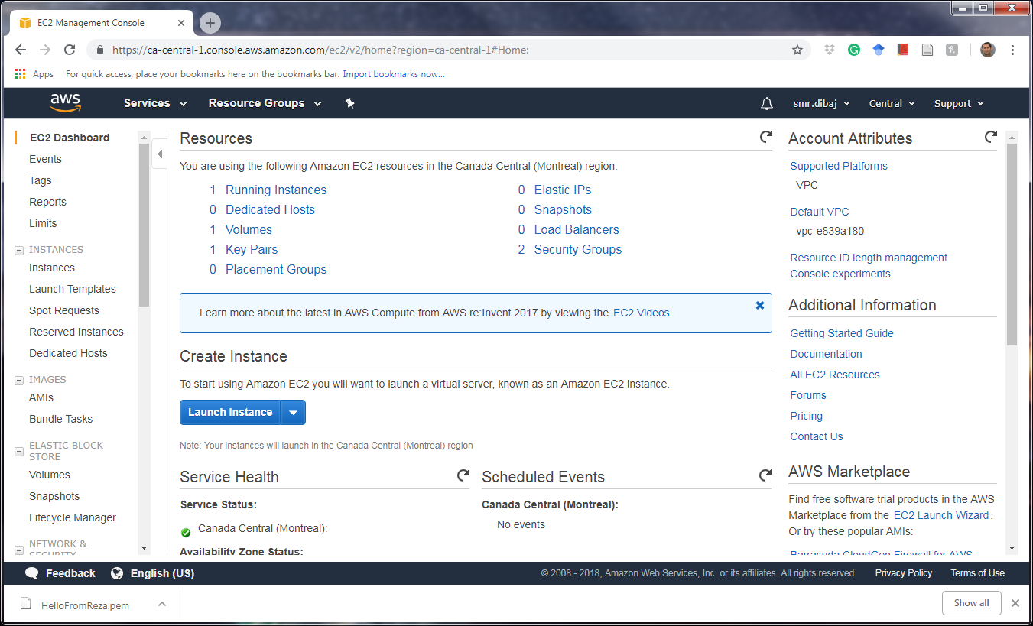
Launch EC2 Instance

Slide 21
Launch EC2 Instance

Slide 22
Connect to Launched Instance

Slide 23
Launch EC2 Instance
Step 11:

Slide 24
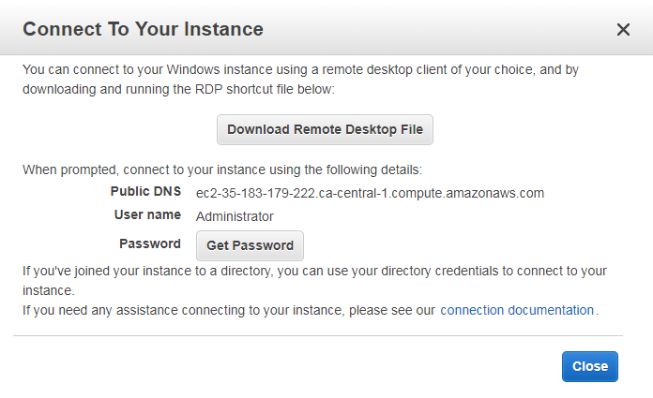
Launch EC2 Instance
Step 12:

Slide 25
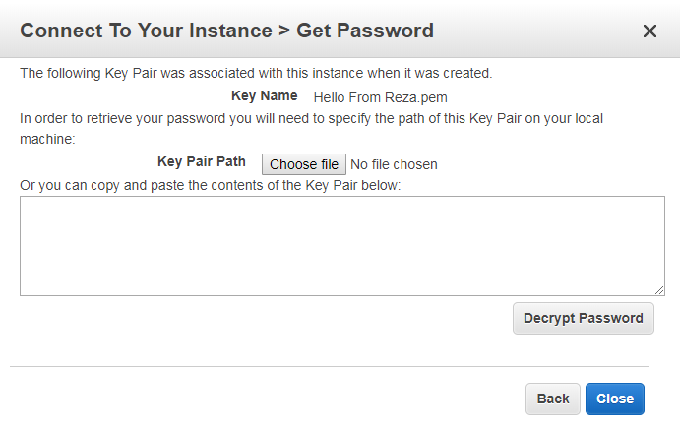
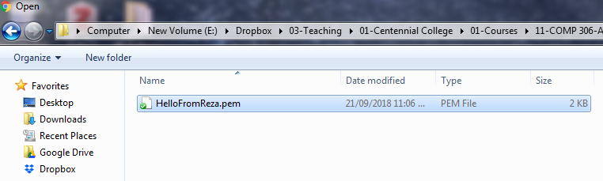
Launch EC2 Instance
Step 13:

Slide 26
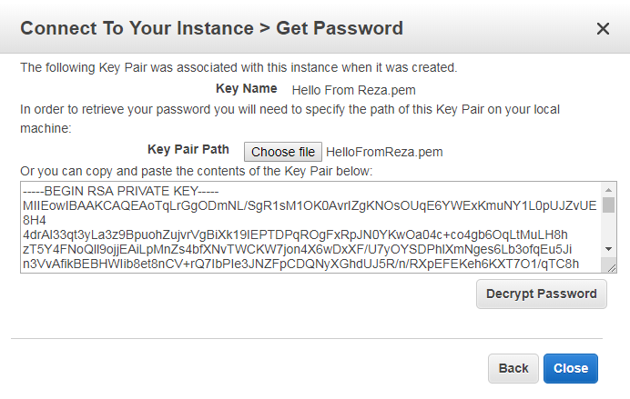
Launch EC2 Instance
Step 14:

Slide 27
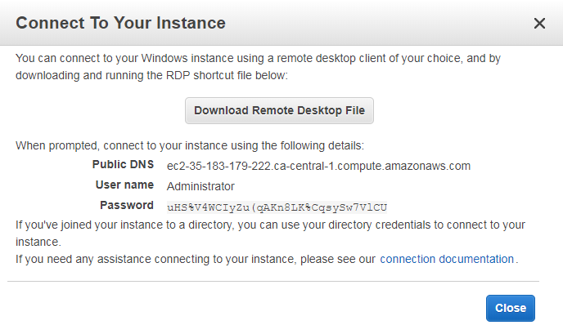
Launch EC2 Instance
Step 15:

Slide 28
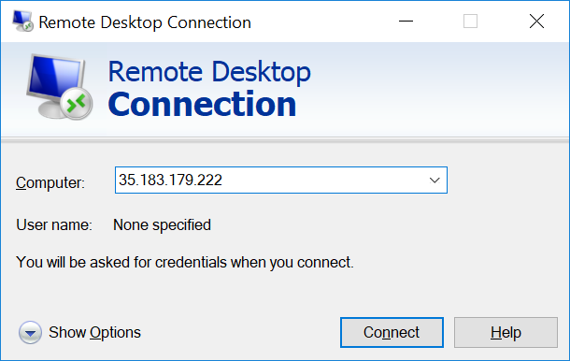
Launch EC2 Instance
Step 16:

Slide 29
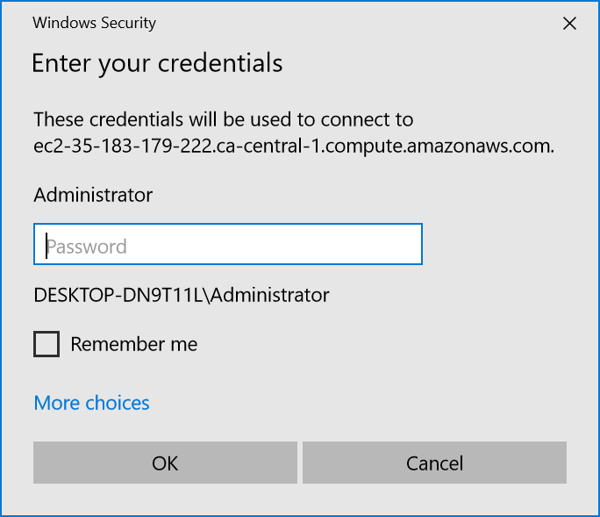
Launch EC2 Instance
Step 17:

Slide 30
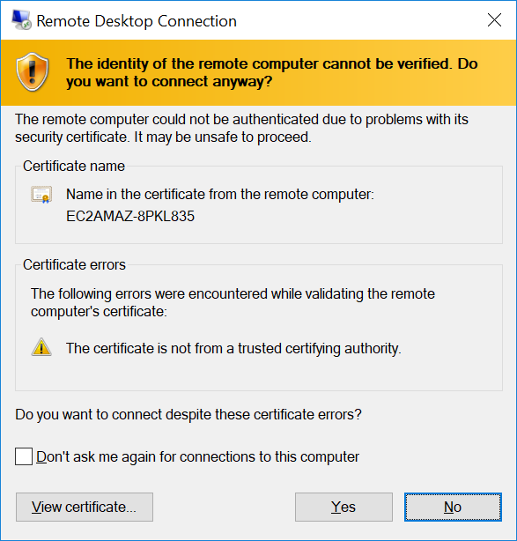
Launch EC2 Instance
Step 18:

Slide 31
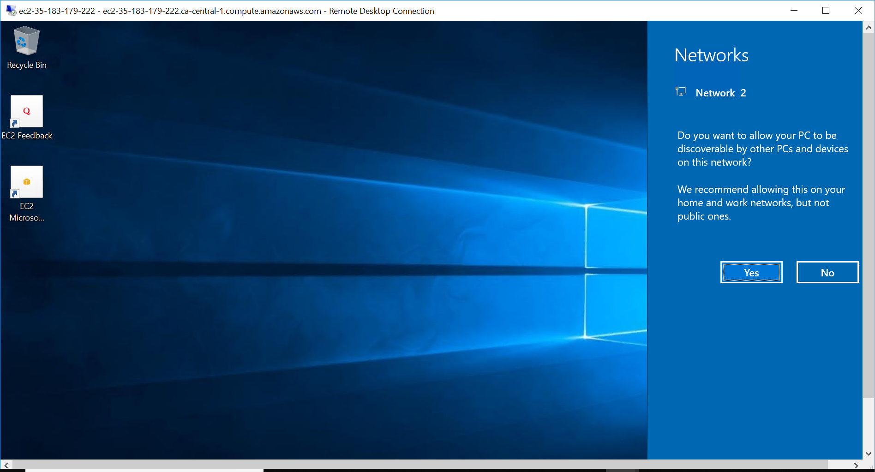
Launch EC2 Instance
Step 19:

Slide 32
Thank you

